Slide 1
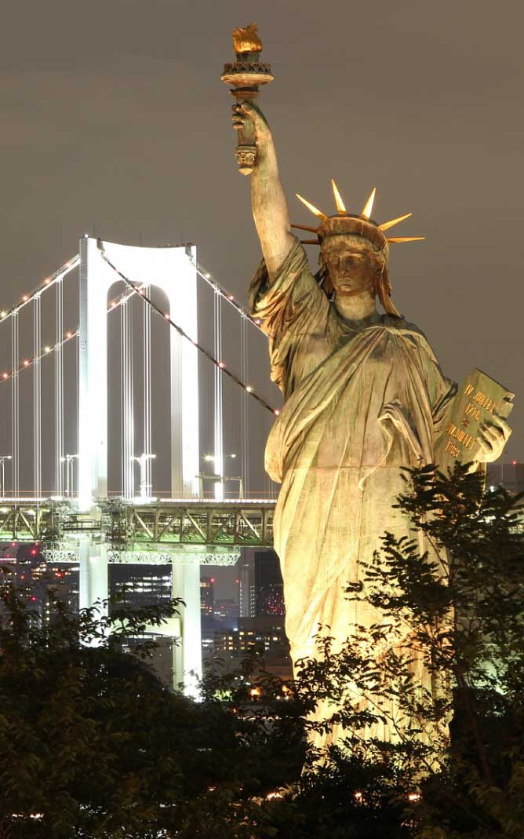
Analysis and Predictions of International Tourist Arrivals in the United States
By: Jenna Reinert, Uroob Mullick, Jalpaben Patel & Sandhya Suresh

Slide 2
Problem
Travel industry on halt due to pandemic.
As the covid restrictions emerged, there is a decline in travel plans.
Impacting the country’s revenue in terms of pleasure and business travels put on hold.
High level of uncertainty in predicting travel forecast.
Due to the huge drop in 2020, it will be challenging to forecast what the future travel will look like.
Identifying areas of focus and target market for improving tourism is taxing

Slide 3
Flow Diagram
Raw data from NTTO
Source: trade.gov
Data cleaning
Tools used: Excel
Predictions based on past data trends using Simple mathematical models
Tools used: Excel, VBA
Data visualization exhibiting the current and future data trend
Tools used: Tableau

Slide 4
Data Cleaning
The input raw data obtained from the trade.gov website had information about number of arrivals to the United States based on various categories such as Region, Country, Port of Entry, Visa type for years 1999-2020.
Since these data was in wide format and was present in multiple files separated for each year, it had to be grouped and cleansed for further analysis and visualizations.
Primarily Excel’s Get and Transform tools and some other excel functions like index and match, transpose, etc. was used in data cleaning. The usage of the functions is described as follows.
The index and match functions have been used to find the appropriate region for each country.
Get and Transform Tool has been used to convert the raw data from wide to long format (As it was suitable for the visualization tool).
Range names have been used in the formulas instead of cell references.
Transpose function has also been used in the data clean-up process.
Some of the input fields have extra spaces which made it difficult to analyze. To clean up the raw data, the trim() function has been used.

Slide 5
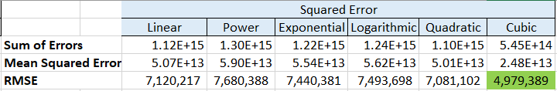
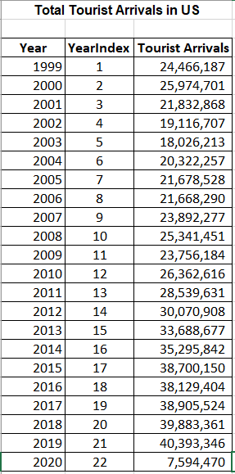
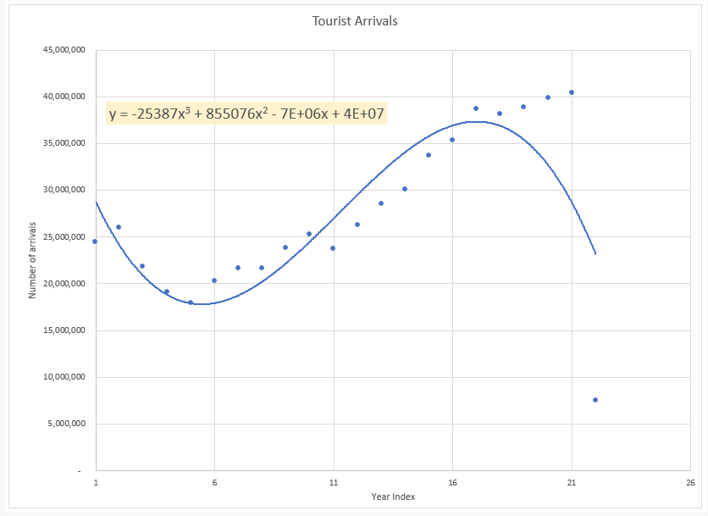
Creating the model

Slide 6
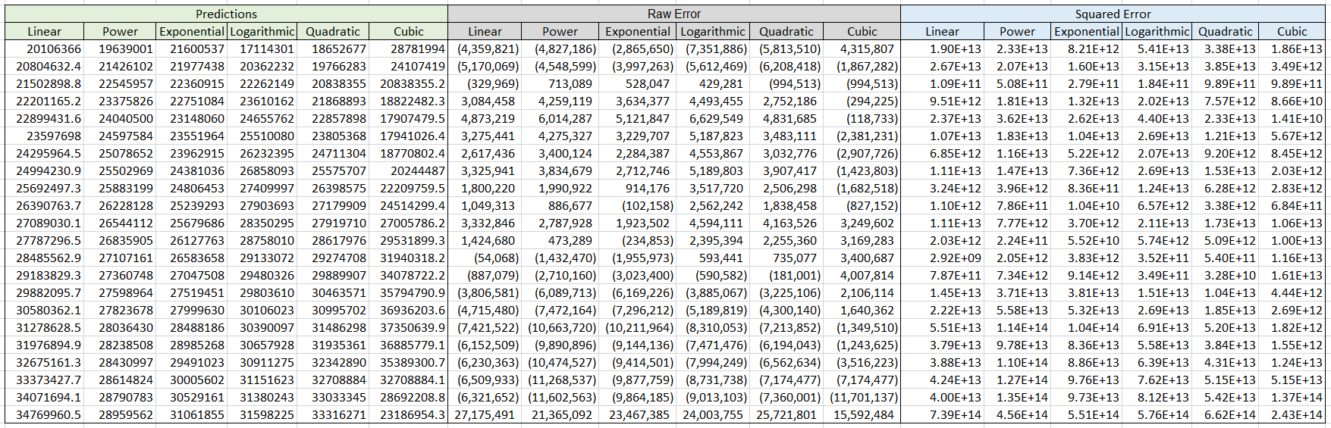
Output

Slide 7
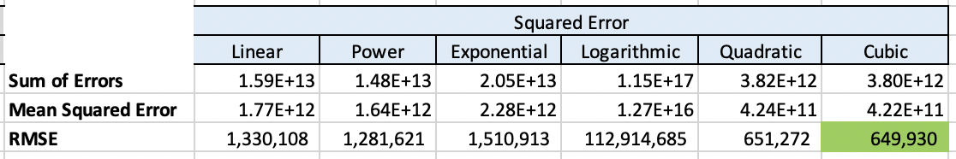
Making Predictions – The Cubic Model

Slide 9
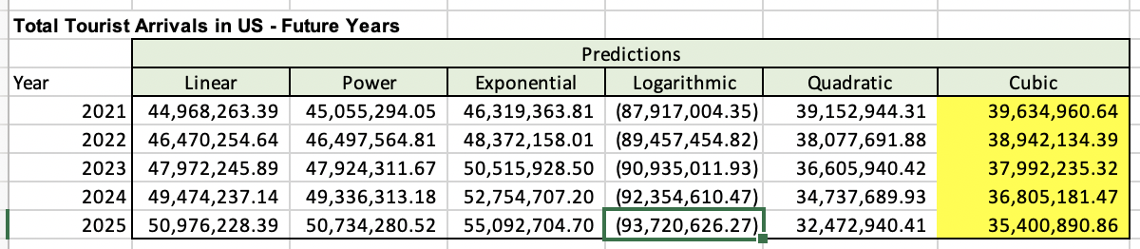
Making Predictions - Result
Model was made using years 2011-2019 as the base
Cubic function was the best fit, so we based our final prediction on that mathematical model

Slide 10
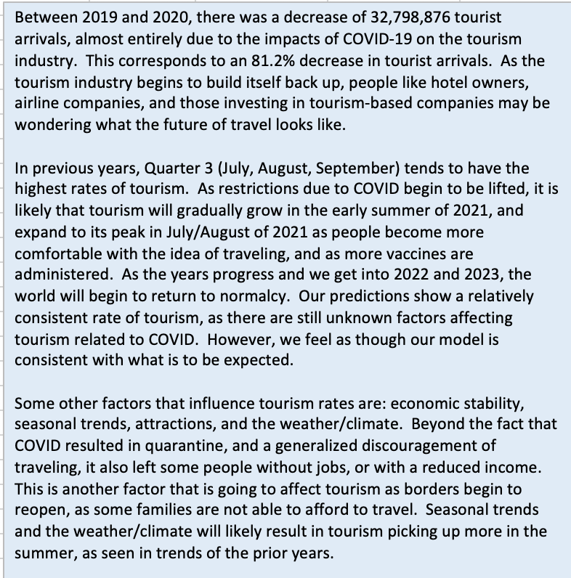
Factors Affecting Tourism

Slide 11

Data Visualization
Interactive dashboards have been created to address the following queries using Tableau
Overall arrival trend (1999-2020)
Top regions that had the greatest number of arrivals
Regions that contribute to least number of arrivals
Top Countries contributing to most arrivals and least arrivals
Overall country wise distribution of number of arrivals
Busiest Ports of Entry in the United States
Overall arrival trend based on port of entry
Visa type contributing to highest number of arrivals
Visa Type contributing to highest number of arrivals in each region
Percent Change in number of arrivals by Month

Slide 12
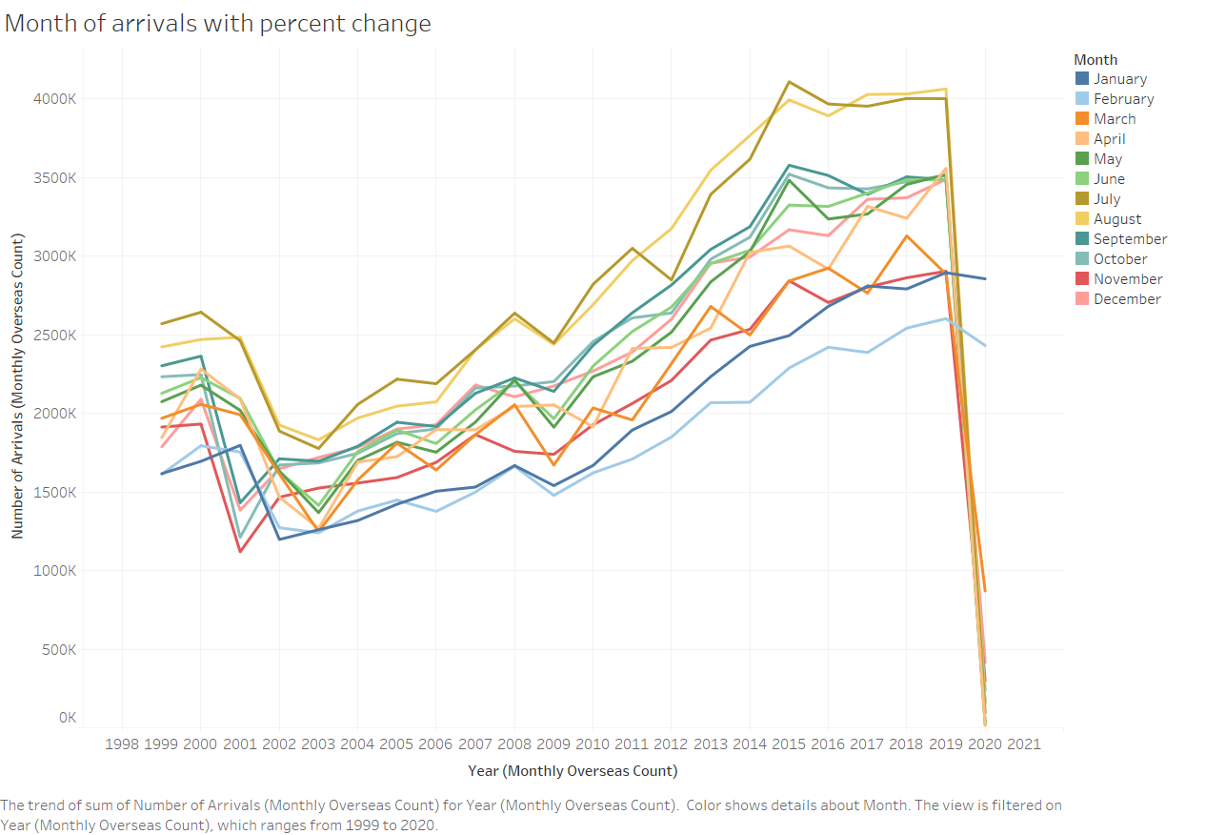
Here, We found that there is a pattern between number of arrival in each month. Like July and August month share maximum arrival whereas January and February have least number of arrival.
Month of arrivals with percent change

Slide 13
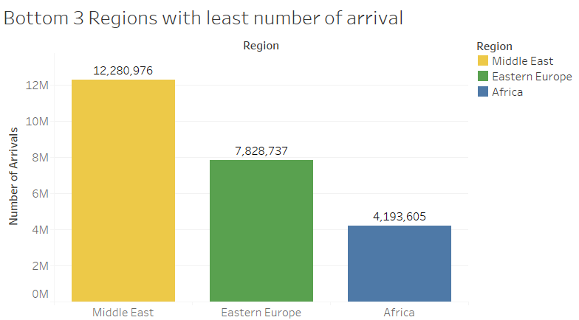
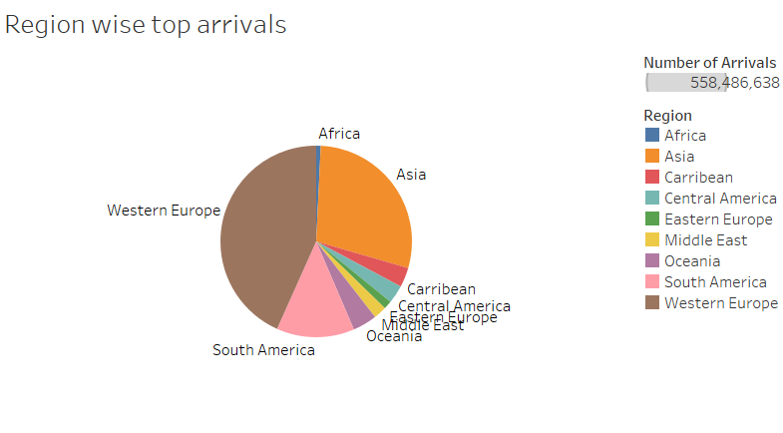
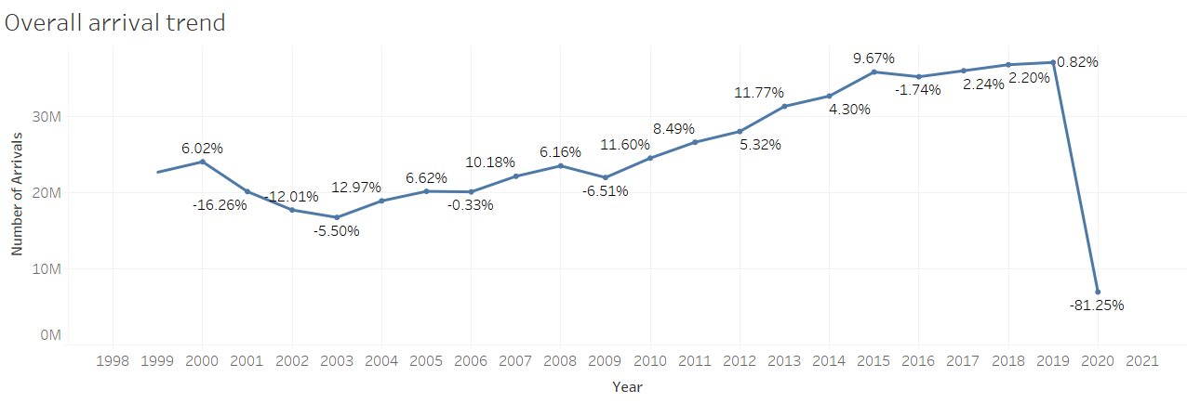
Western Europe, Asia and South America are region, which contribute more tourist entry in United States.
Whereas Middle East, Eastern Europe and Africa have least tourist count.
Overall arrival trend increase over the period of time. But in 2020 due to pandemic and travel restriction, there was huge fall in arrival.

Slide 14

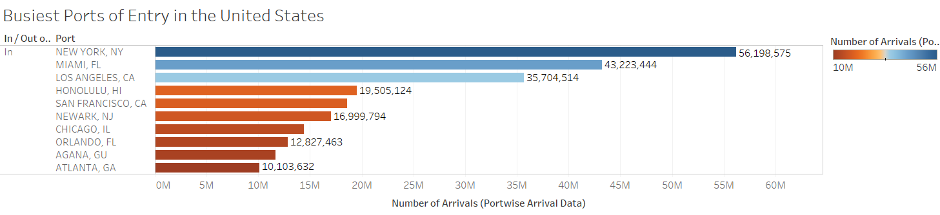
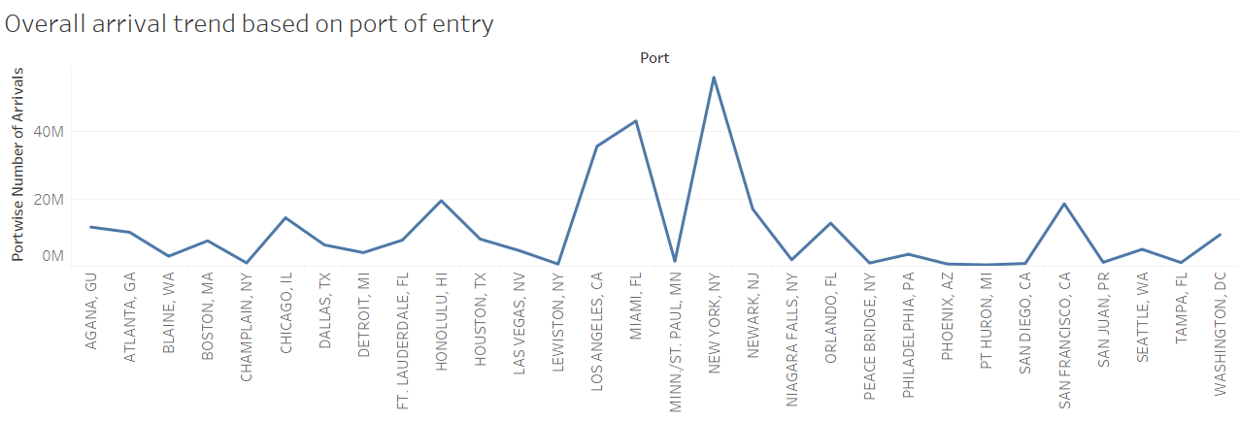

Slide 15
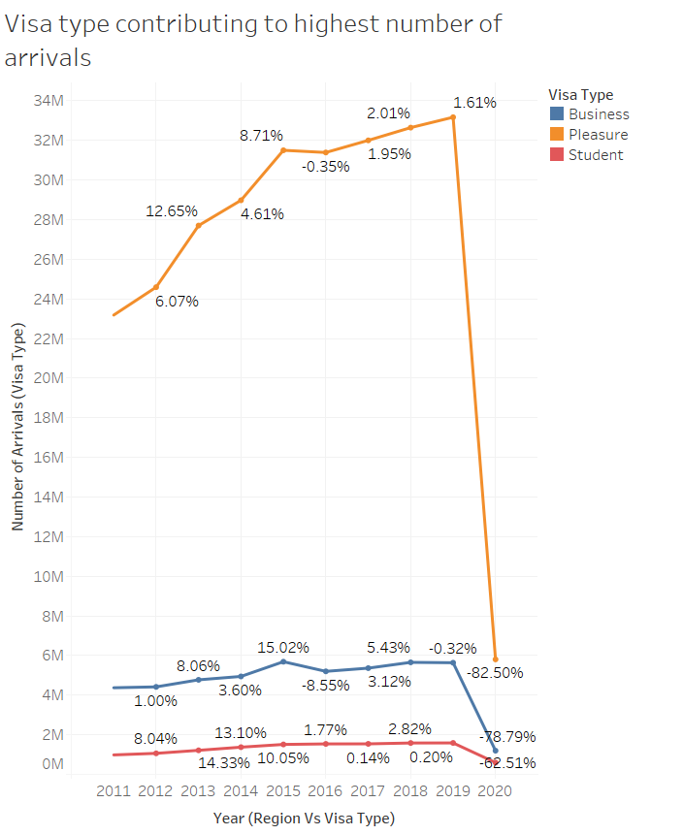
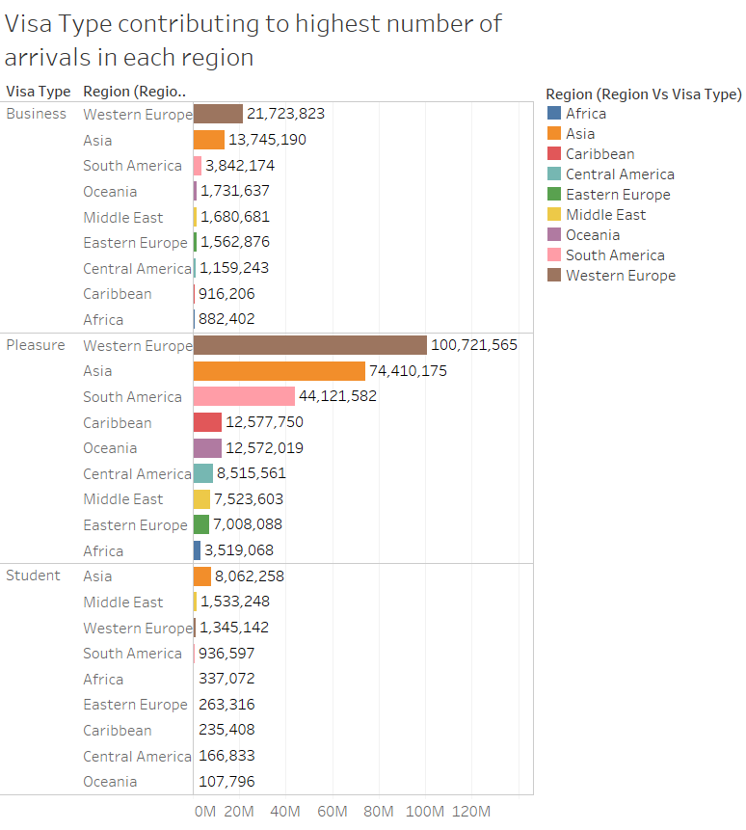

Slide 16
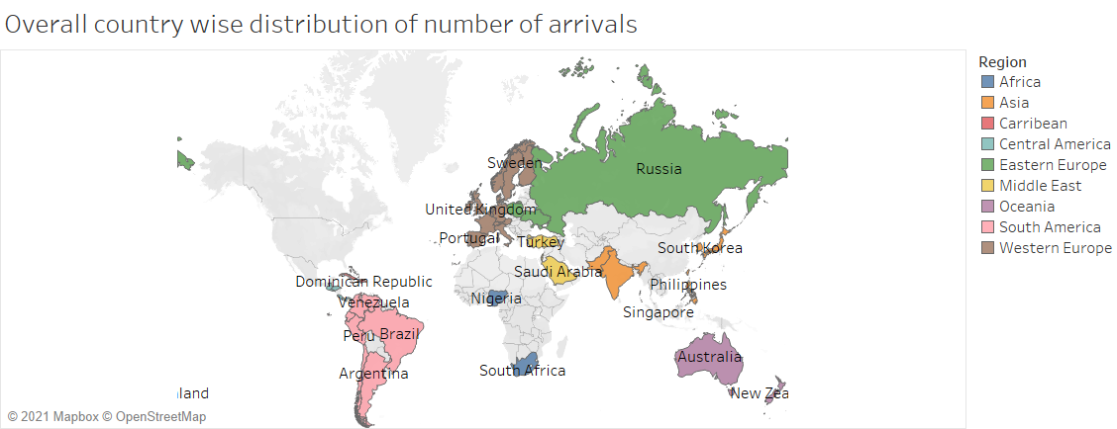
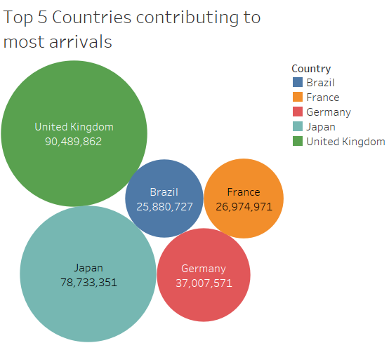
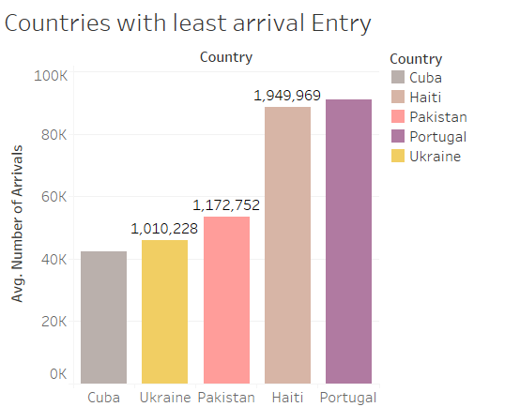
Any traveler taking a trip to a main destination outside their residence, for business, pleasure, study purpose. Previous slide shows that Maximum tourist arrive with Pleasure visa type and mainly from Western Europe and Asia region.
Map based on Longitude and latitude. Colors shows details about region. The marks are labeled by County.
United Kingdom, Japan, Brazil, Germany and France contribute more tourist entry in United States.
Whereas Cuba, Ukraine, Pakistan, Haiti and Portugal have least tourist count.
New York, NY and Miami, FL are the busiest port.

Slide 17
Capabilities:
Tableau helped us visualize raw data in form of multiple dashboards.
Identify trends and patterns from analyzed data which can help Tourism companies to yield important decisions.
Through this project we would be aiding the US tourism industry including airlines, hotels and ground transportation businesses by predicting international tourist arrivals trends in the US which they can use for making investment related decisions.
With the help of our prediction model, additional data can be analyzed for forecasting number of arrivals for future years with reduced manual effort (As we have automated the prediction for best fit model using VBA).

Slide 18
Limitations:
We did not have country wise data for different visa types which would have helped us to provide a data comparison based on the number of arrivals from different countries and visa types.
Also, the I-94 data from the website have only the Port of entry details but do not have any information about the destination. If we have those details, it will be more useful for the people from tourism industry as there could be cases where port of entry is different from the destination of travelers.
Our project does not provide a user-friendly form to add additional data in the model automatically and search for regional and country wise data for their own analysis.
Our prediction is based on simple mathematical model, and it does not consider any external factors impacting the number of arrivals.

Slide 19
Development and Analysis Challenges
In developing our model for predictions, we faced a challenge due to the dramatic decrease in tourists from 2019 to 2020 which made us to eliminate the 2020 data for making predictions. When forming the predictions based on 2016 to 2020, we were getting negative values for the future year predictions, though that is impossible.
The input data had extra spaces which made it difficult to analyze. The index and match functions failed due to this reason
During automation of RMSE calculation, we ran into subscript out of range error while calculating the prediction values for quadratic and cubic functions as the data was populated using array function.
During initial data compilation we tried to combine the raw data based on year as it was common for all categories. But that structure proved to be incompatible for visualization purposes
We tried creating interactive drop-down list for year wise arrival data based on Port of entry but instead used filter option.

Slide 20

Thank You

